Slide 1
Session 5
Other Issues in Warfare

Slide 2
Warring for Our Communities
Same principles apply at every level
Enemy has attachment points
Collective sins, rituals/ceremonies, loyalties normal means
The Twilight Labyrinth by George Otis, Jr.
Finding the sources is trickier when not dealing w/individuals
God reveals it
Research
Spiritual mapping—K.I.S.S. style
Pray over area: Address sin, do reconciliation work, evangelism
Healing Wounded History by Russ Parker; “Transformations” videos

Slide 3
Warring for Homes/Places
Question of the “what” can be more of an issue
E.g., Physical issues, place memories, poltergeist phenomena
Is the issue with the place or a demonized person within it?
Approach may vary based on level of bondage
General cleansing & blessing prayers through the place
Find & remove occult & pagan objects
Occult/pagan history on the site can make things… interesting
Celebrate the Eucharist in the home
Exorcised water & salt and consecrated oil can be important
Owners have unique authority over the location

Slide 4
C.Q.s: Objects & Spiritual Power
Controversial in some Christian circles
Leftover from the Reformation
Still, Christian, pagan, & occult worldviews all believe objects can transfer spiritual power
In pagan worldviews, object itself can be source of power
Seen in Scripture
Temple/Tabernacle items, Elisha’s bones, Jesus’s robes, Paul’s cloths
Pagan/Occult items=Spiritual Counterfeits
Tangible benefit in spiritual warfare

Slide 5
Tips in Praying for Communities & Places
Discern your call for such ministry—no unauthorized fights!
Ask the Lord to send angels to address things
Remember, directly confronting high-level spirits is questionable
If possible, focus on as specific of a location as possible
E.g., a particular corner or business in a neighborhood or spot in a room in a house
Research spiritual history of critical locations
Significant events, especially traumas or sins, are often key
Pray for Jesus’ death & resurrection/victory to cleanse the place

Slide 6
Specific about Communities & Places
Prayer walks through the community
Ask the Lord to direct the walk, stops, & what you notice & pray
When you research, ask Him to guide you to critical info
ONLY ENGAGE ENEMIES AS CALLED TO DO SO!
Occult groups sometimes work against such ministry efforts
Sacraments & sacramentals seem especially effective here
Some groups object to such theology/practice; doesn’t change results!
Rifts between groups sometimes need healing to break bonds
Divisions between Christian groups 100% need to be healed

Slide 7
Example of Community Spiritual Warfare
Two crosses, 1 Adult World store
I-75 north, TN, north of Knoxville
The store target of many prayers
Crosses deliberately placed
Notice where your eyes go…
Spiritual atmosphere of such stores? Foul!
Store is no longer there
Hard to find online articles, though

Slide 8
Practical Example: Hotel Rooms
Sometimes detect dark presences
Never know what your hotel room was doing…
Pray over different parts of the room upon arrival
Main room, bathroom, bed, TV…
Pray blood of Jesus over sins committed in the room
Bless the room & later occupants
May have a right to the room but not to attack YOU

Slide 9
Haunted Houses
People see, hear, or sense something unusual
May be subtle, may be extreme
Range of issues
Sometimes desperate to be believed
Have to determine/discern cause
Physical? Mental? Spiritual?
Issue with the place or a person?
Is issue time-related?
100% bless place & people
Prayers should address sources

Slide 10
Team Warfare: Intercessory Cover
In modern warfare, airpower protects ground forces
Spotters & suppressors of enemy air & artillery
Same goes for intercessory prayer
Moses & Joshua Prayer
Doers = Joshua Work
Intercessory Cover = Moses Work
Important to critical when doing major spiritual warfare work
E.g., going into spiritually volatile places or doing high-stakes min.
Watchmen on the Wall—A Tremendously Helpful Model!

Slide 11
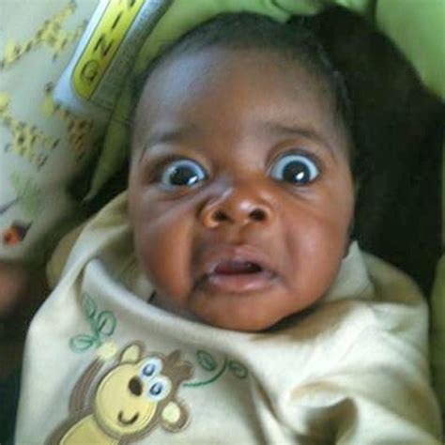
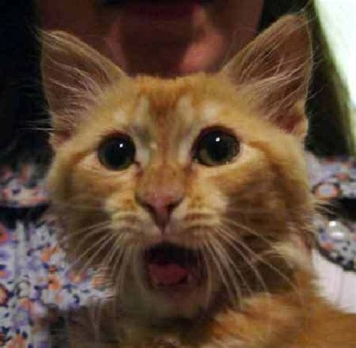
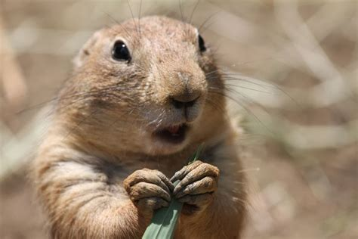
Final Thoughts
Worldview must be solid in Christ but open to the weird 🡪
Walk in faith & no freaking out!
Must have a heart for those for whom Christ died
Even people who do seriously evil things
It’s about Jesus & the love of God, not evil & the enemy’s power
Understand Power vs Authority
Robber vs. DA vs. Cop
Grow: Learn, Study, & DO

Slide 12
Last Chance Q&A

