Slide 1

Session 4
Freeing Others

Slide 2
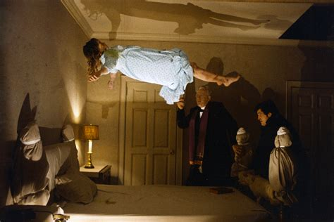
Slaying Misconceptions
People think it’s always this 🡪
  Hint: It’s not!
God, demons, and most people aren’t deaf, so volume’s pointless
  So are emotional antics!
God in us is > the enemy. Period.
  They want us to be afraid. Don’t be!
Can it be complicated? So what?!
  Life—and people—are messy
It’s not always a crisis

Slide 3
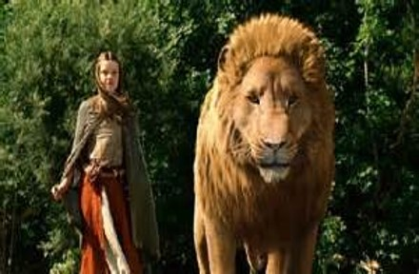
Jesus is Lord & Focus of the Ministry
It’s about bringing people closer to Jesus, not just about freeing them from the enemy
  Goal is to help them know Him better
It’s not about us or our knowledge, or even our connection to God
  Pride is a leading temptation in this ministry
    Have to know our own sins
    Humility: Possible reason we face backlash
Working as a team highlights Him

Slide 4
Basic Process
Discern need to address demonic bondage
Cut off enemy communications & prohibit manifestations
Uncover & address sources of demonic attachments
Expel spirits (if they’re still there)
Pray for filling with and cleansing by Holy Spirit
Seal with the blood of Jesus
Counsel the individual on discipleship needs & assist as needed
Follow-up as necessary

Slide 5
Keys to the Process
James 4:7: “Submit therefore to God. Resist the devil and he will flee from you.”
  The whole process is about helping the person do this!
Engage the person’s will as much as possible in the process
  They need to invite Jesus to address sources of attachment and do whatever is needed for them to be removed
  They must renounce the spirits
  Often important for them to command them to leave
    This can be the key point in the process
MUST be guided by the Lord yourself—the process is His!

Slide 6
Bondage: A Few Basic Points
Severity = Number + Type + Amount of Garbage
  The greater the numbers, the greater the severity
  Some types strong than others (occult/idolatry spirits usually stronger)
  The more garbage there is, the stronger the hold
    More Open Doors=More & Better-Fed “Guests”
    Active Christian growth helps weaken bondage
Clusters are more common than not
Types of Demons
  Correspond to function and association—can help locate attachments

Slide 7
Recognizing Bondage
Their history reveals potential open doors
Problems have kept going in spite of best/right efforts
A spirit manifests in some way
  In response to command to manifest
  At revealing times
    E.g., Disruptive reaction to ministry
      Direct manifestations
      Subtle(-ish) interference: Mood changes, intrusive thoughts, trouble focusing, physical issues, team comes under attack, ministry halts, false Jesus/images, distortions
God reveals it

Slide 8
C.Q.s: What About Mental Health Issues?
Can be tricky to differentiate
Not always “Either/Or”
Check the background
  Family history, trauma, occult involvement, pagan worship, etc.
    Mental health issues & demonization often have different sources
Demons act differently, so you can test for their presence
  Watch for resistance while removing ground
  Can use commands & sacramentals
Be suspect of personal claims of demonization!

Slide 9

Preparing the Battlespace
Request Lord’s presence & reign
  Good to ask Him to send angels to help
Forbid communication & manifestations
  Between every enemy spirit present
  Between those present and those elsewhere
  Between every enemy spirit and the minds of everyone present
  Unless commanded in Jesus’ Name
Forbid any interference

Slide 10
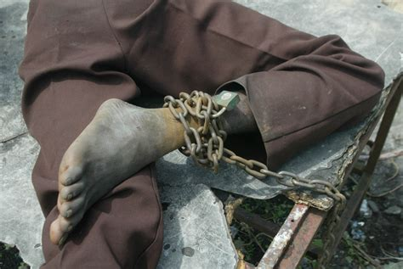
Common Sources of Bondage
Unconfessed/Unrepentant Sin
Unresolved Emotional Wounds
  Memories, Lies, Emotional Responses
Unforgiveness
Vows & Self-Curses
Occult Issues & False Spirituality
Soul Ties
  Sexual activity &/or emotional intimacy
Generational Issues
  Curses, Sins, Trauma

Slide 11

Finding Point of Attachment/“Ground”
Always verify what you hear!
Three Sources
  God
  Person
    Interview reveals source (their history)
    Sometimes they know
  The Enemy
    Through interrogation
    The type of enemy can tell a LOT
      The enemy’s name can reveal source

Slide 12
C.Q.’s: Getting Info from/about the Enemy?
Some (wrongly) think the enemy can’t speak the truth
  They did with Jesus…
God can—and does—force them to reveal things they want to keep secret
  They are weakened when compelled to reveal truth
Jesus Himself sought background information
  From enemy: Luke 8:30: The enemy’s name
  From family member: Mark 9:21: Asked the boy’s father for background information

Slide 13
Clearing the Ground
Confession and Renunciation
  Sins, false beliefs, inner vows, resentments, ungodly desires, etc.
Forgiving
Healing of Memories/Emotional Wounds
Cutting of Soul Ties & Ties to Ancestral Sins
Breaking of ALL Ties to Occult/False Religions/Non-Christ-centered Spiritualities
  Removing and destroying occult/idolatrous objects/literature/images...
Re-Commitment of Self/Faculties/Emotions/Etc. to Jesus

Slide 14
Getting Particular
Much of this can be done through repeat-after-me prayers
  Benefit in “The Steps to Freedom in Christ” and “Unbound” models
Healing of memories controversial in some circles
  Some believe use of imagination in prayer to be a New Age method
Should be as holistic and comprehensive as possible
  Care for the whole person
Vows & Curses: Can be tough to break
  Can be sealed or implemented systematically, e.g., secret society oaths
Need to watch for interference during every activity

Slide 15
Addressing the Spirits: Using Authority
Only need to confront the spirits enough to help the person act
  Sometimes the best course is for them to push through opposition!
Sometimes have to directly confront the enemy
  Person’s will or mind may be too weak to engage
    Weaken the enemy & strengthen the person’s will
    Means bouncing between confronting the enemy & working w/recipient
May sometimes be led to command the spirits to depart
All believers have authority to expel demons
  May be enhanced by ordination/appointment; protection in the latter

Slide 16
Kicking Them Out: More Particulars
When commanding demons to leave, command them to go:
  Silently: No big manifestations & no communicating with other spirits
  Directly: No detours to mess with other people or do other evil works
  Immediately: No delaying
Recommend commanding them to go Jesus for Him to deal with them as He wills
  Why not to the Cross, to the abyss, to hell, or back to Satan?
    Seem to be bound by time but not space
    He 100% has the authority to send them to the abyss or hell but we may not
    They’d actually rather face Jesus than Satan so may be more resistant to leave

Slide 17
Wrap-up
Always ask the Lord to fill & cleanse any place left empty
  Avoid the return w/others, a la Matt. 12:43-45/Luke 11:24-26
Good to pray a sealing of the healing w/the blood of Jesus
Usually need to do some counseling for continued healing/growth or how to stay free
  Shouldn’t be the focus of the session
  Some need to be put into a life-giving community/body
Follow-up is always needed for all of us
  We’re never fully healed this side of the Resurrection!

Slide 18
Exorcise
Get in groups of 3
Cast a demon out of someone in your trio
JUST KIDDING! ☺

Slide 19
Questions?

